Slide 1
Devise & Sight Notices
Online Notice Board
Guided By :-Prof P. A Chaudhari.

Slide 2
Contents
Introduction
Literature Survey
Scope & Objective
Software / Hardware Requirements
System Architecture.
Current Status
Conclusion

Slide 3
Introduction
Web Application
Admin and student need to login / signup.
Admin will manage notice dashboard, student, and student corner.
Student see notice, manage their profile & post on student corner.

Slide 4
Literature Survey
Displayed notices on notice board of colleges.
Notices displayed on physical notices boards can be messed up with other notices.
Missing of useful information. And ease of existing system
In holidays or absence students can’t be able to know about information.
One will get the useful information through call, messages from teachers or friends or on social media too but they may get tends to forget to convey that message to you so this application will help you to provide information through without fail.
Existing system are there in android application example. St Lawrence app. But such application are not specific to only notice board content only.

Slide 5
Scope & Objectives
Scope:
Project scales up to displaying notices as well as manage them.
Viewer of notices see and manage their profile.
Requires internet to get notification through mails.
One can not use messaging application, mail id is needed.
Student corner will consist of various post in image format.

Slide 6
Scope & Objectives
Student will be notified through email.
Objectives:
To help create, manipulates the notices.
To enable users to see notices with precedence of their priority.
To allow student to post creative skills in student corner.
To convey important information to students with proper mentioned instruction.

Slide 7
Software / Hardware Requirement.
Software Requirement:
Windows 10 Operating system.
Internet Connection.
Hardware Requirement:
Laptop.
Mobile.

Slide 8
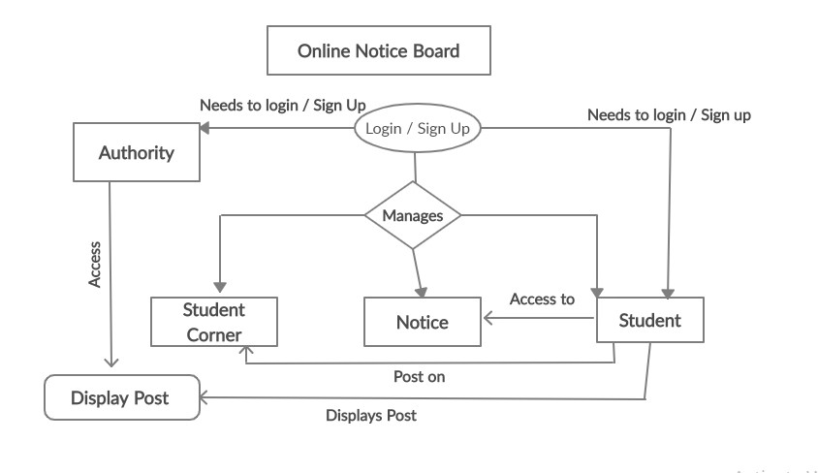
System Architecture

Slide 9
Current Status
Designing is done of following:
Index Page, Login page of authority and student completed.
Sign-Up Page of authority and student completed.
Header and footer of the pages are done.
Admin and Student dashboard design.
Update profile of admin done.
Post in Art-Villa , Manage notice, Manage Art-Villa and revamp student profile designing completed.

Slide 10
Conclusion
The project deals with managing the notices, student who are accessing these.
Handling Art-Villa [student corner].

